Slide 1
ICF 4:
Scoring Federal Contracts
Notes:
############# Competitiveness' part starts ##############
output$distPlot.competitive <- renderPlot({
if(input$select4==1){
idx = (cbp$numberofoffersreceived <= input$offer)
cbp %>%
filter(idx) %>%
ggplot(aes(x=numberofoffersreceived)) + geom_histogram(fill="green") +
theme(axis.title.x = element_text(size = 20)) +
theme(axis.title.y = element_text(size = 20)) +
theme(plot.title = element_text(size = 20, face = "bold")) +
ggtitle("Number of contracts based on bids") +
labs(x="Number of bids", y="Count")
}else if(input$select4==2){
idx = (cbp$vender.revenue <= input$revenue)
cbp %>%
filter(idx) %>%
ggplot(aes(x=vender.revenue)) + geom_histogram(fill="red") +
theme(axis.title.x = element_text(size = 20)) +
theme(axis.title.y = element_text(size = 20)) +
theme(plot.title = element_text(size = 20, face = "bold")) +
ggtitle("Number of contracts based on vender revenue") +
labs(x="Vender revenue", y="Count")
}else {
idx = (cbp$numberofemployee <= input$employee)
cbp %>%
filter(idx) %>%
ggplot(aes(x=numberofemployee)) + geom_histogram(fill="blue") +
theme(axis.title.x = element_text(size = 20)) +
theme(axis.title.y = element_text(size = 20)) +
theme(plot.title = element_text(size = 20, face = "bold")) +
ggtitle("Number of contracts based on vender's employees") +
labs(x="Number of vender's employees", y="Count")
}
}) ## Competitiveness part ends

Slide 2
Research Question
Which federal contracts
are most important?
Notes:
“How to determine the federal contracts that are most important to you?

Slide 3
Method
We build a scoring system using 3 factors:
Contract Score = 1) + 2) + 3)
Dollar Amount … the bigger contract size,
the higher score
Competitiveness … the less competitive,
the higher score
Category Match … the more matches, the higher score
Notes:
The budget associated with each contract.

Slide 4
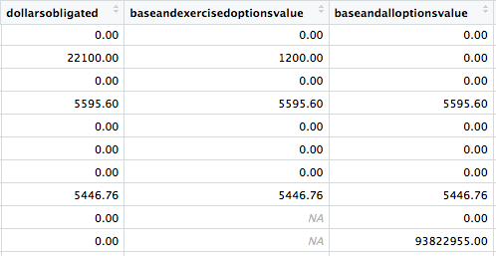
Dollar Amount ( Contract size )
Case A:
Case B:
Notes:
- 3 types of dollar amounts

Slide 5
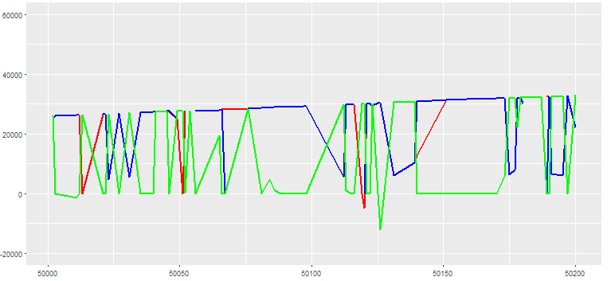
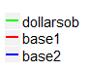
Dollar Amount ( Contract size )
We use max value of potential contract sizes (dollarsobligated, base1, base2).
Amount 2
Dollar Amount
Contract ID
Notes:
- 3 types of dollar amounts

Slide 6
Competitiveness
Contract Score = Dollar Amount + Competitiveness + Category Match
Number of Bids a contract receives
Number of Employees within a company
Company Revenue, how much revenue a company receives annually
Notes:
- Function: (1 - (X/Maximum Score))*100
-

Slide 7
Competitiveness
A contract is less competitive if …
Number of Bids is small
Company Annual Revenue is small
Number of Employees is small
Contract Score = Dollar Amount + Competitiveness + Category Match
Notes:
- Function: (1 - (X/Maximum Score))*100
-

Slide 8
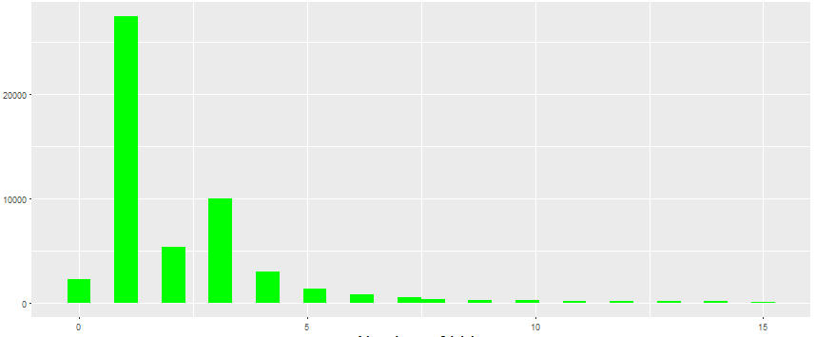
Competitiveness
1）Number of Bids
Number of contract
Number of bids
Notes:
- the more bids a contract received, the smaller its score
- the least competitive contracts have the highest score

Slide 9
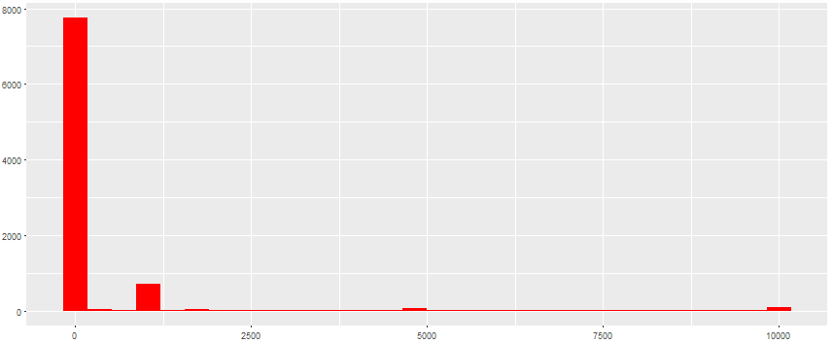
Competitiveness
2）Company Annual Revenue
Number of contract
Company Revenue
Notes:
- Very few contracts belong to companies with more than 100,000 in annual revenue
- Function: (1 - (X/Maximum Score))*100

Slide 10
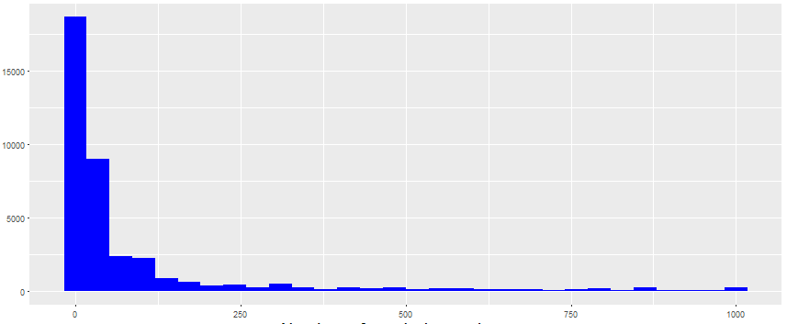
Competitiveness
3）Number of Employees
Number of contracts
Number of employees
Notes:
- the greater the number of employees the lower the score

Slide 11
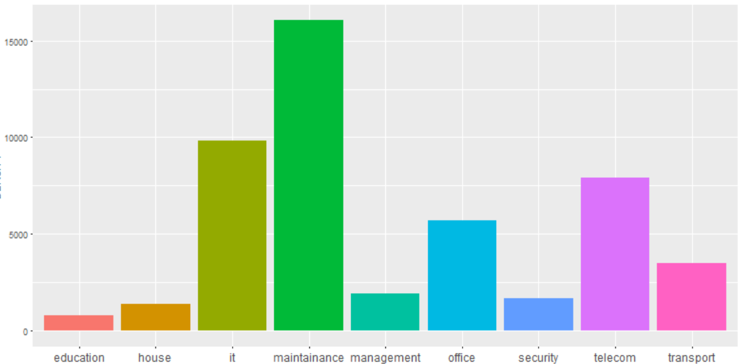
Category Match
ex) Description A:
Description B:
Category match is defined by keywords appearing in the contracts description.
7520: OFFICE DEVICES AND ACCESSORIES
D399: IT AND TELECOM- OTHER IT AND TELECOMMUNICATIONS
IT
Telecom
Office
Count
Category Score:
B > A
x: Category

Slide 12
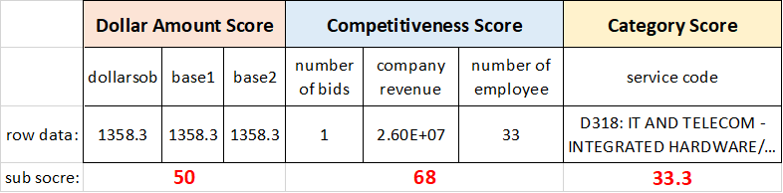
Example of calculation process
1
Weight
50% of Dollar Amount score
30 % of Competitiveness score
20 % of Category score
Contract Score =
50% *50 (Dollar Amount sore)
+ 30%*68 (Competitiveness score)
+ 20 % *33.3(Category score)

Slide 13
Which of the three factors should be weighed the most?
We define ...
the best way to prioritize the factors
the best distribution of scores

Slide 14
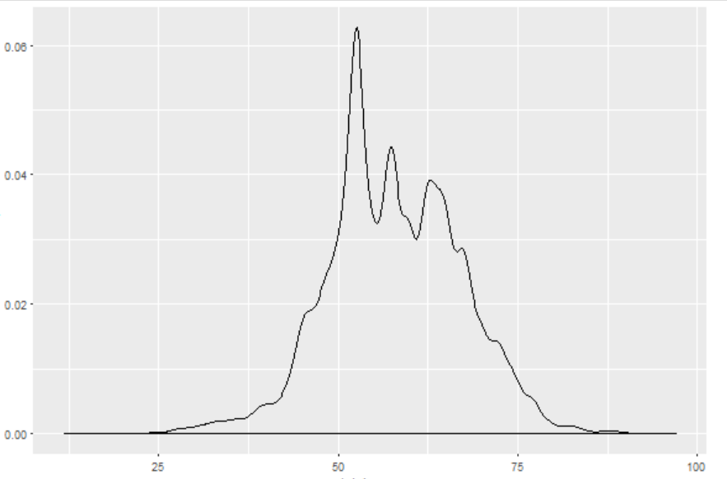
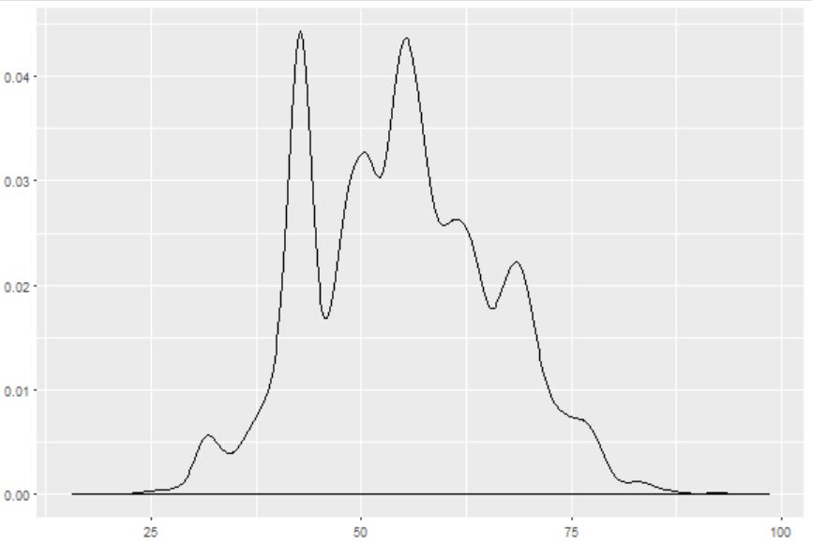
Distribution of the Score
Worst distribution
(Variance: 70.4)
Best distribution
(Variance: 200.7)
Density
score
score
Notes:
- best and worst distributions

Slide 15
Conclusion
We conclude that contracts of higher score based on the following calculation are more important.
Contract Score =
20% of Dollar Amount sore +
50 % of Competitiveness sore +
30 % of Category score
Notes:
- best and worst distributions

